Slide 1
Text Analytics
Ayush Guraria, Intern - Quest Global

Slide 2
Text Analytics
Overview
Application of statistical and ML techniques to be able to predict any info from the mined data

Slide 3
Text Analytics: Operations
To name a few:
Associative analysis
Visualisation
Predictive Analysis
Information retrieval
Lexical analysis
Pattern recognition
Tagging/annotation

Slide 4
Use Cases
Human Resource Management
To manage human resources, that aim at analyzing staff’s opinions, monitoring the level of employee satisfaction.
Reading CVs for the selection of new personnel.
Market Analysis
For analyzing competitors or monitoring customers’ opinions
Identifying new potential customers
Determining the companies’ image through the analysis of press reviews and other relevant sources.
Social Media Data Analysis
Extracting opinions, emotions and sentiment and their relations with brands and products

Slide 5
Text Analytics Software
Open Source
Apache OpenNLP
Stanford's CoreNLP
GATE & Apache UIMA
SpaCy

Slide 6

Apache OpenNLP
Name Entity Recognition
Document Categorizer
Sentence Detection
Parts of Speech Tagging
Tokenization
Command Line Interface provided for convenience of experiments and training
Java Library
Price - Free

Slide 7

Stanford's CoreNLP
Token and sentence boundaries
Parts of speech
Named entities
Numeric and time values
Dependency and constituency parses
Coreference, sentiment, quote attributions, and relations.
Supports 6 languages: Arabic, Chinese, English, French, German, and Spanish
Java Library
Price - Free

Slide 8

GATE & Apache UIMA
Standardizes and abstracts much of the repetitive work that goes into building a complex NLP application.
Very flexible scale out capability based on JMS (Java Messaging Services) and ActiveMQ
Provides cluster management services to automate the scale-out of UIMA pipelines over computing clusters
Enables applications to be decomposed into components.
For example "language identification" => "language specific segmentation"
=> "sentence boundary detection" => "entity detection (person/place names etc.)".

Slide 9
GATE & Apache UIMA
Each component implements interfaces defined by the framework and provides self-describing metadata via XML descriptor files.
The framework manages these components and the data flow between them.
Can wrap components as network services and can scale to very large volumes by replicating processing pipelines over a cluster of networked nodes.
Available for both C++ & Java. Supporting annotators written in C/C++, also supports Perl, Python, and TCL annotators.
Price - Free

Slide 10

SpaCy
Supports deep learning workflows that allow connecting statistical models trained by popular machine learning libraries like TensorFlow, PyTorch or MXNet through its own machine learning library Thinc.
Using Thinc as its backend, SpaCy features convolutional neural network models for part-of-speech tagging, dependency parsing, text categorization and named entity recognition (NER)
Tokenization for more than 50 languages
Available for English, German, Greek, Spanish, Portuguese, French, Italian, Dutch, Lithuanian and Norwegian

Slide 11
SpaCy
Non-destructive tokenization
Named entity recognition
"Alpha tokenization" support for over 50 languages
Statistical models for 11 languages
Pre-trained word vectors
Part-of-speech tagging
Labelled dependency parsing
Syntax-driven sentence segmentation
Text classification
Built-in visualizers for syntax and named entities
Deep learning integration

Slide 12
SpaCy
Extensions and Visualizers
Thinc: A machine learning library optimized for CPU usage and deep learning with text input.
sense2vec: A library for computing word similarities, based on Word2vec and sense2vec.
displaCy: An open-source dependency parse tree visualizer built with JavaScript, CSS and SVG.
displaCyENT: An open-source named entity visualizer built with JavaScript and CSS.
Language – Python
Price - Free

Slide 13
Text Analytics Software
Cloud Source
Amazon Comprehend
IBM Watson
Google Cloud Natural Language API
Microsoft Azure Text Analytics API

Slide 14

Amazon Comprehend
Key Phrase Extraction
Sentiment Analysis
Syntax Analysis
Entity Recognition
Comprehend Medical
Medical Named Entity and Relationship Extraction (NERe)
The Medical NERe API returns the medical information such as medication, medical condition, test, treatment and procedures (TTP), anatomy, and Protected Health Information (PHI). It also identifies relationships between extracted sub-types associated to Medications and TTP. There is also contextual information provided as entity “traits” (negation, or if a diagnosis is a sign or symptom). The table below shows the extracted information with relevant sub-types and entity traits.
Medical Ontology Linking
The Medical Ontology Linking APIs identifies medical information and links them to codes and concepts in standard medical ontologies. The Medical Ontology Linking APIs also detects contextual information as entity traits (e.g. negation).

Slide 15
Amazon Comprehend
Custom Entities
Custom Entities allows you to customize Amazon Comprehend to identify terms that are specific to your domain. Using AutoML, Comprehend will learn from a small private index of examples (for example, a list of policy numbers and text in which they are used), and then train a private, custom model to recognize these terms in any other block of text. There are no servers to manage, and no algorithms to master.
Language Detection – Over 100 languages and returns the dominant language with a confidence score to support that a language is dominant.
Custom Classification
The Custom Classification API enables you to easily build custom text classification models using your business-specific labels without learning ML.
Topic Modeling
Topic Modeling identifies relevant terms or topics from a collection of documents stored in Amazon S3. It will identify the most common topics in the collection and organize them in groups and then map which documents belong to which topic.
Can perform text analysis on English, French, German, Italian, Portuguese, and Spanish texts.

Slide 16

IBM Watson
Sentiment Analysis
Returns targeted sentiment and emotion towards keywords for deeper analysis
Analyzes text to extract meta-data from content
AlchemyLanguage is a collection of APIs that offer text analysis through natural language processing.

Slide 17

Google Cloud Natural Language API
Syntax Analysis
Entity Analysis
Sentiment Analysis
Entity Sentiment Analysis
Multi-Language
Integrated REST API
Healthcare Natural Language AI
Real-time analysis of insights stored in unstructured medical text
Can integrate Google’s AI tools with our Cloud Storage

Slide 18

Microsoft Azure Text Analytics API
Sentiment analysis
Key phrase extraction
Language detection Entity Sentiment Analysis
POS-tagging
Multi-Language
No training data is needed to use this API
Can be integrated with Azure cloud

Slide 19
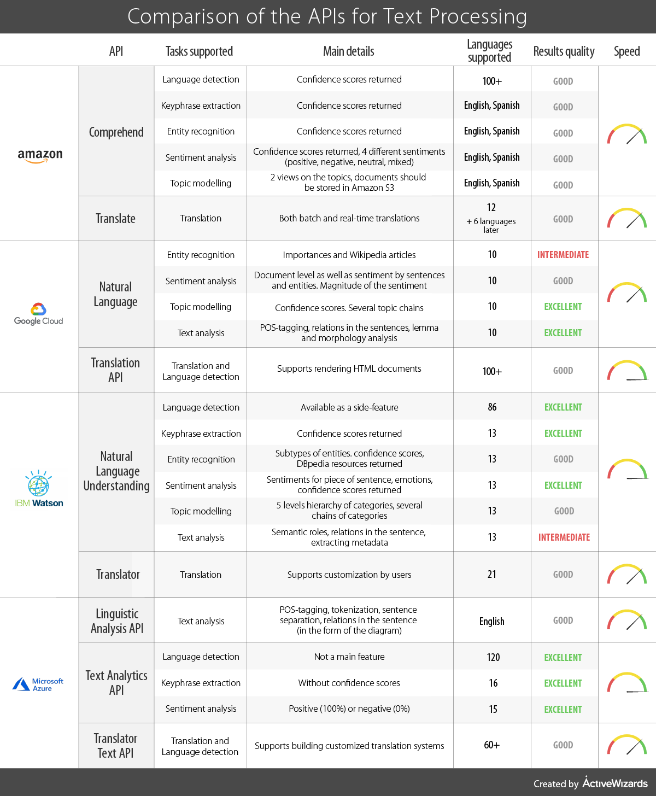
Comparative
Study
Between
Cloud Based
Software

Slide 20
Comparative
Study
Between
Cloud Based
Software

Slide 21
The End

